Slide 1
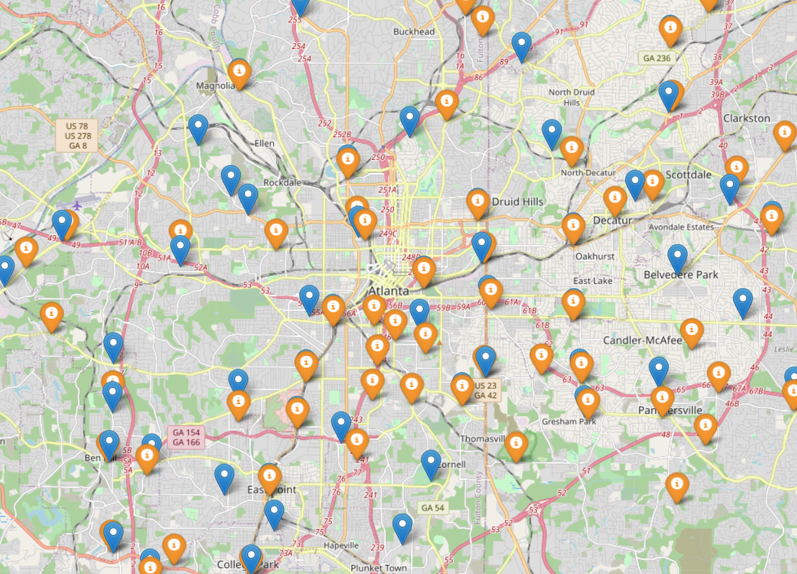
Optimization Draft
Goal
Select best potential hub locations to reduce overall transportation cost.
Data
Current hub location points: 57 locations obtained from odmts_main.py.
Potential hub location points: 92 locations obtained from board_id dataset using DBSCAN clustering
will test Weighted-Kmeans & HDBSACN later

Slide 2
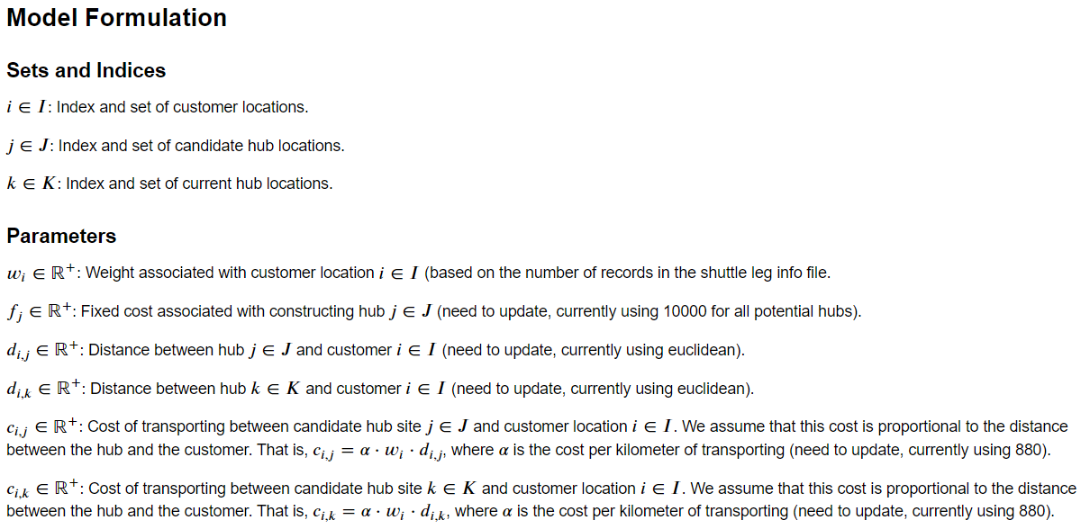
Optimization Draft Cont.

Slide 3
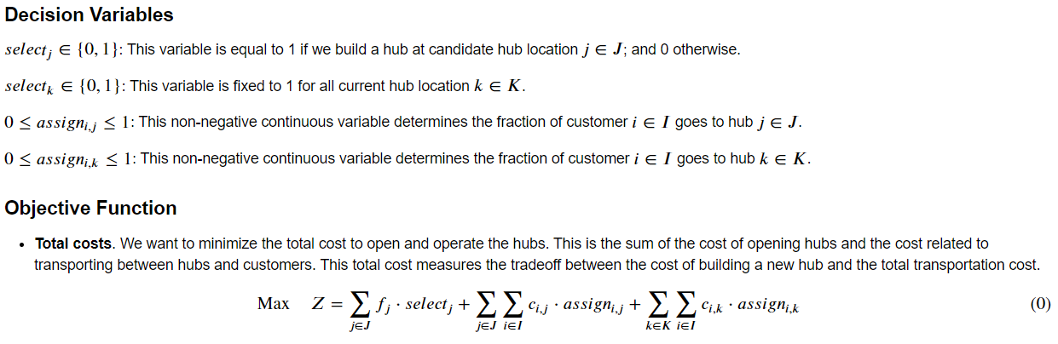
Optimization Draft Cont.

Slide 4
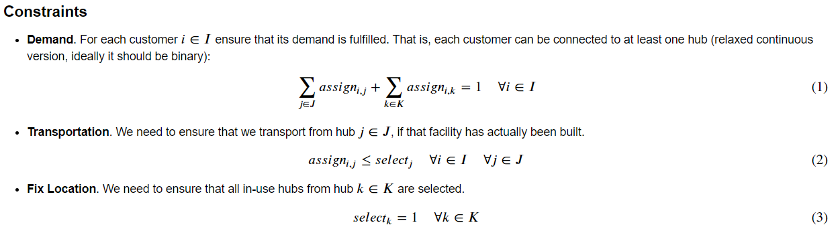
Optimization Draft Cont.

Slide 5

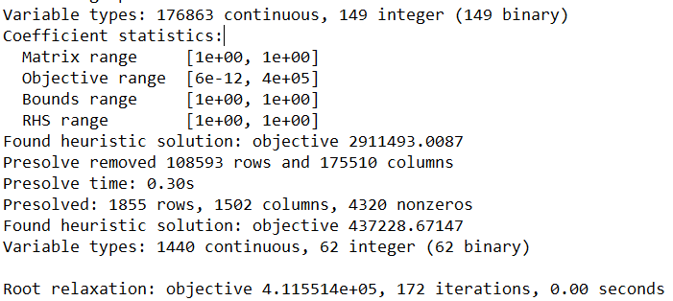
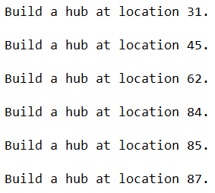
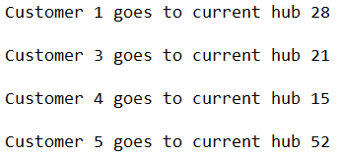
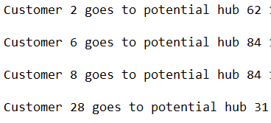
What the output shows
# of shuttle stops
# of existing hubs
#of potential hubs
Location of existing hubs
Overall transportation cost
Location of selected potential hubs
Which customer goes to which hub (whether go to an existing hub or a selected potential hub)

Slide 6
What’s next
Update distance/cost parameters
Feed potential hub results into the current network design
Observe changes in convenience, cost, travel time etc.
Adjust/polishing the current optimization model (take more factors into consideration)
Use Weighted K-Means and HDBSCAN to generate potential hubs
Compare optimization results (3 sets of potential hubs)

